Slide 1
Searching Algorithms

Slide 2
Searching algorithms
Searching Algorithms are designed to check or retrieve an element from any data structure where it is being stored.
They are classified 2 categories according to their type of search operations.
1.Sequential Search: In this, the list or array is traversed sequentially and every element is checked. For example: Linear Search
2.Interval Search: These algorithms are specifically designed for searching in sorted data-structures. These type of searching algorithms are more efficient than Linear Search method, as they repeatedly target the center of the search structure and divide the search space in 2 half. For Example: Binary Search.

Slide 3
Types of Searching Algorithms
Linear Search
Binary Search
Jump Search
Interpolation Search
Exponential Search
Fibonacci Search

Slide 4
Linear search
A linear search or sequential search is a method for finding an element within a list.
This type of searching algorithms sequentially checks each element of the list until a match is found or the whole list has been searched.
A linear search runs in at worst linear time and makes at most n comparisons, where n is the length of the list.

Slide 5
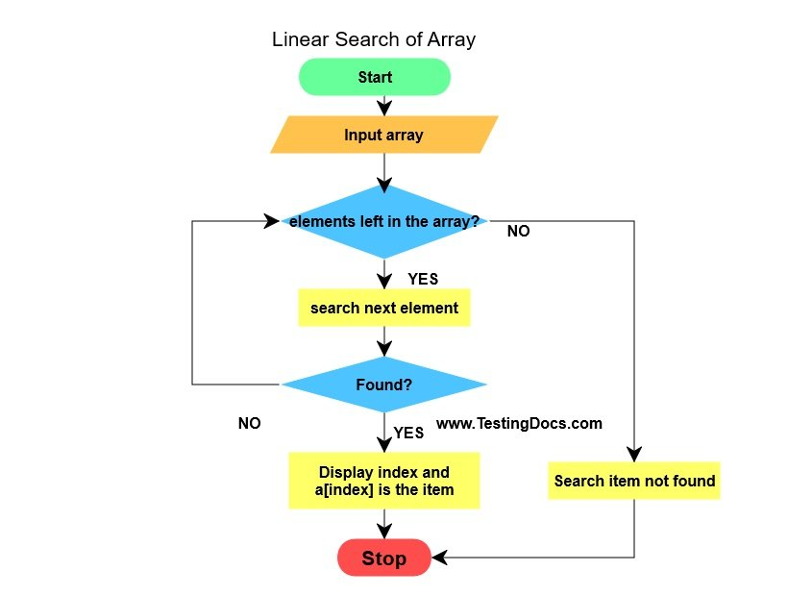
Flow chart representation of Linear Search
The Big O Notation used in this algorithms is O(n), where n is the number of comparisons .
In the best case,time complexity would be O(1).
Average case is the sum of all off the case devided by number of cases.n+1/2
Can be used in sort and sorted arrays.

Slide 6
Binary Search
This type of searching algorithms is used to find position of a specific value contained in a sorted array
A binary search is also known as a half-interval search or logarithmic search.
This type of algorithms used in sorted arrays.If it is not,we can’t apply Binary Search.

Slide 7
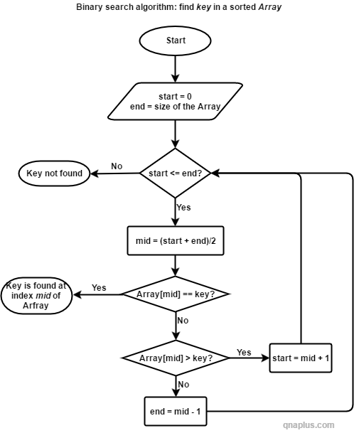
Flow chart representation of Binary Search
Binary Search is devide by half technique.It means it is going to devide the array two half.
Case 1:var==arr[mid] it will return mid
Case 2:var<arr[mid] r=mid-1
Case 3:var>arr[mid] l=mid+1
mid=l+r/2
This Binary Search is executed logn times.It is the worst case(also average) time complexity O(logn).Best case when l+r/2==var then the time complexity would be → O(1)
O(logn) is better O(n)

Slide 8
Jump search
In Jump Search we are not going to check each all of element.We are starting from the first element then let’s guess jump size m=3,it will skip from index 0 directly to index 3 then index 6 and so on.
Jump Search is always work if the array is sorted
If after jumping we will not right boundary it means we have to start linear search from the last low index.This loop will continue when the element will be equal to target.
Worst case time complexity: if there are n elements and we are deviding it m number of block, n/m jumps+ linear search time complexity in here: O(n/m+(m-1)).
Best case: if we will find the element without linear search,then :O(n/m)
Jump Search time complexity is better than linear search,Binary Search the best one.

Slide 9
Interpolation Search
Interpolation search is an improved variant of binary search.
Given array should be sorted :Sorted array of n uniformly distributed values.It means the gap between elements should be equal. [1,2,3,4,5]
pos = lo + [ (x-arr[lo])*(hi-lo) / (arr[hi]-arr[Lo]) ]

Slide 10
Example to Interpolation Search
[1,3,5,7,9,11,13,15] x=9
l=0 → arr[l]=1;h=7 → arr[h]=15
pos = l+ [ (x-arr[l])*(h-l) / (arr[h]-arr[L]) ]=0+[((9-1)*(7-0))/15-1]=4
We find 9 in one step.
In Binary search will do 3 steps in here by deviding half 3 times.That’s why Interpolation search is best if given array is uniformly distributed values

